Slide 1
Improving the efficiency of electric motors in the industrial sector and supporting local manufacturing opportunities
Energy savings in the industrial motor-driven systems, financial and technical feasibilities and the financing schemes
September 2021

Slide 2
Introduction to EE in Egyptian Industry
10 - 15
Billion Dollars
Market size of the energy efficiency market in the industrial sector
8-11%
The possible savings in industrial electric power
3.5%
The possible savings in industrial electric power if high-efficient motors are widely used
Rapidly growing market since 2014 as a result of the development of the energy sector, particularly policies or subsidies removal.
Achieve the basic elements of the institutional framework and political motives
The development of legislation and regulations is slower than that of the market
Accumulated expertise can be used from projects, legislation and experts and can be used to build for further development
Growing interest from the private sector

Slide 3
Introduction to EE in Egyptian Industry
Clarifications
The following symbols will be used in the next slides to denote the characteristics of energy-saving interventions in electric motor systems.
    Degree of deployment
    Ease of Implementation
    Low cost of implementation
    Savings
Low
Average
Good

Slide 4
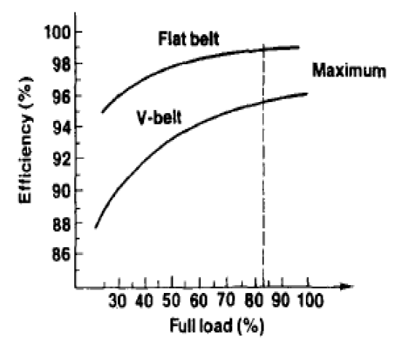
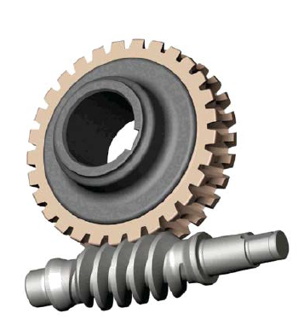
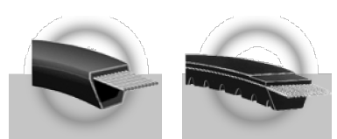

Energy Saving in Motor Systems –
1) Adjusting the coupling elements
Easy-to-implement, low-cost and high-saving intervention with medium prevalence in industrial enterprises
    Degree of deployment
Efficiency
Ease of implementation
Efficiency 50-85 %
Load
1%
Improve in the coupling elements
1 KW saving per shift
30 EGP savings per year
    Cost of implementation
Savings
Efficiency 90-96%
Efficiency 95- 98%

Slide 5
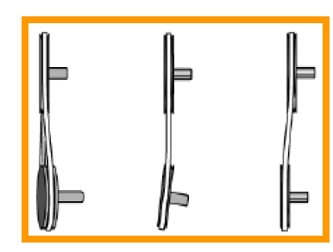
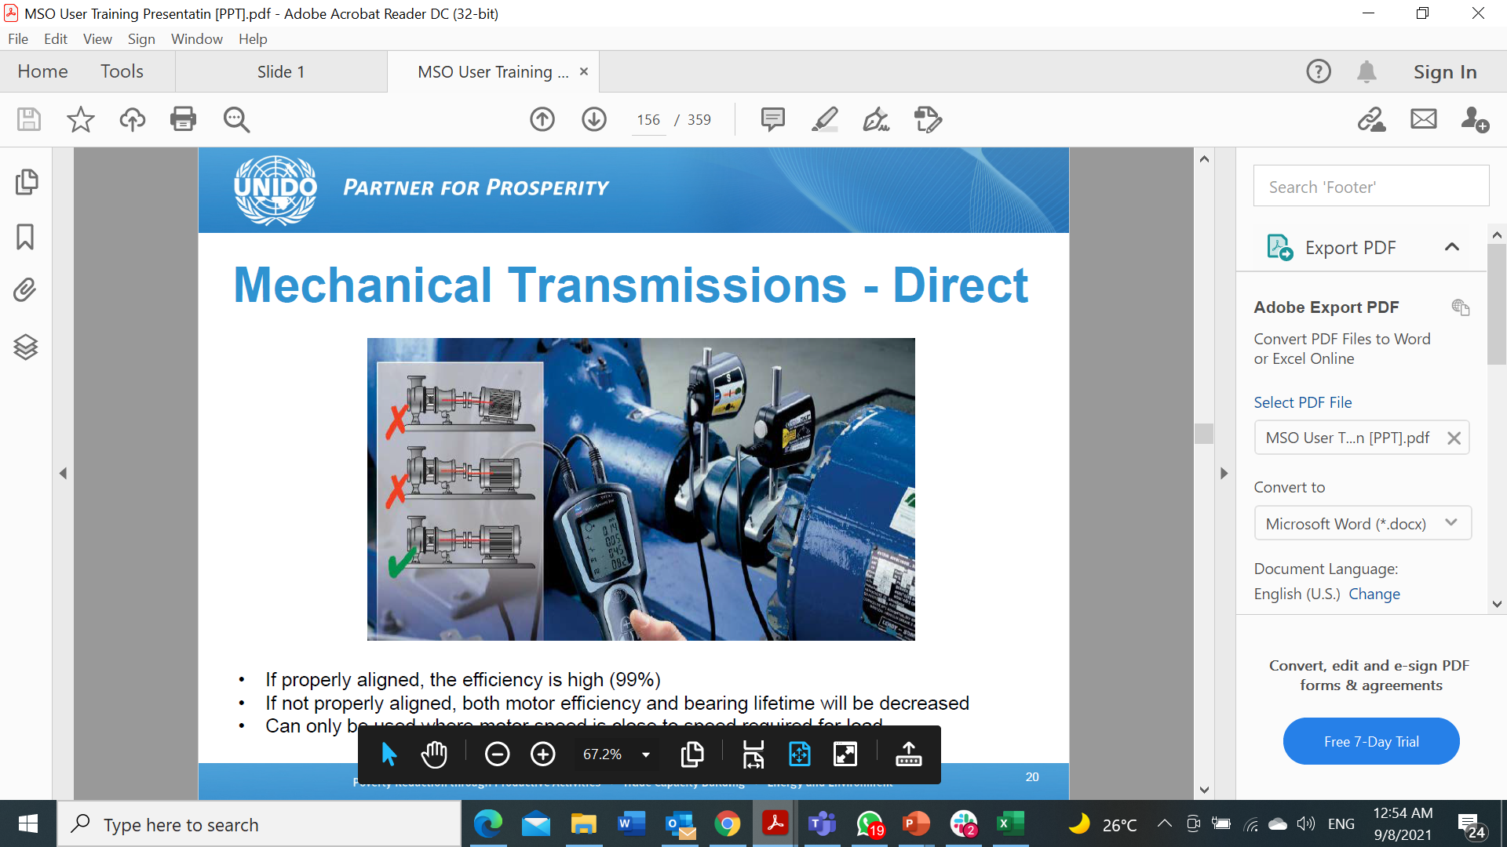
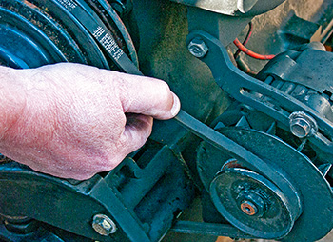
Energy saving in Motor Systems –
1) Adjusting the coupling elements
Misalignment of shafts and lose belts are the most common examples
    Degree of deployment
Ease of implementation
    Cost of implementation
Savings

Slide 6
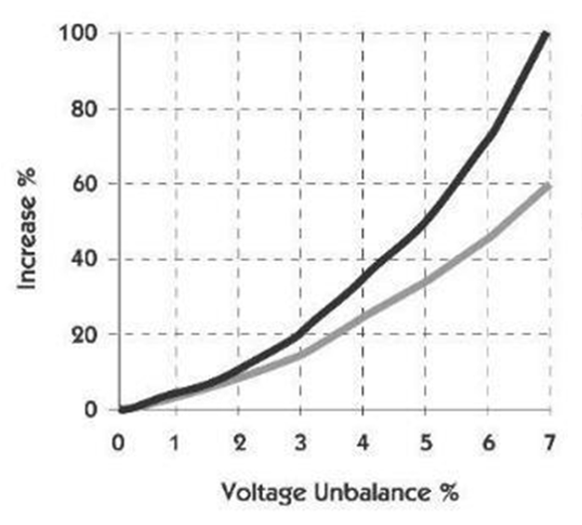
Energy Saving in Motor Systems –
2) Balanced Voltage Source
The unbalance of voltage source (either in magnitude of phase) increases the energy loss and increases the motor temperature, which decreases its lifetime
Unbalance is usually from the feeding transformer or due to load unbalance
    Degree of deployment
Increase in temperature
Ease of implementation
Loss in power
    Cost of implementation
Medium in ease of implementation, low cost, low savings and degree of deployment in industrial enterprises
Savings

Slide 7
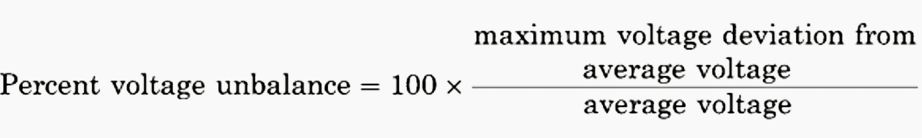
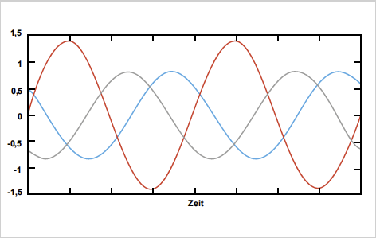
Energy Saving in Motor Systems –
2) Balanced Voltage Source
    Degree of deployment
The efficiency= 90%, the original loss is 10%
The imbalance is 3.6%, causing additional loss of 2% (i.e., 20% of original loss)
Saving: 60 EGP annually per KW (for one shift)
Example
Ease of implementation
    Cost of implementation
Savings

Slide 8
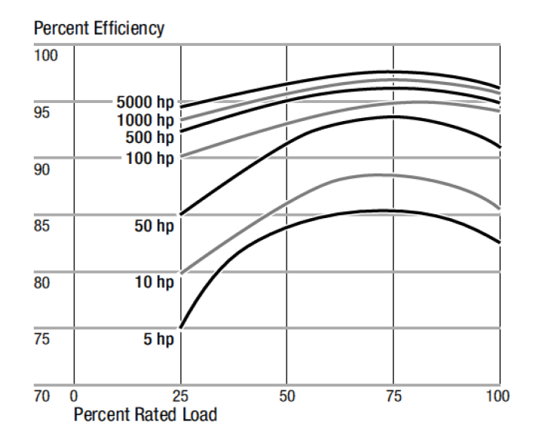
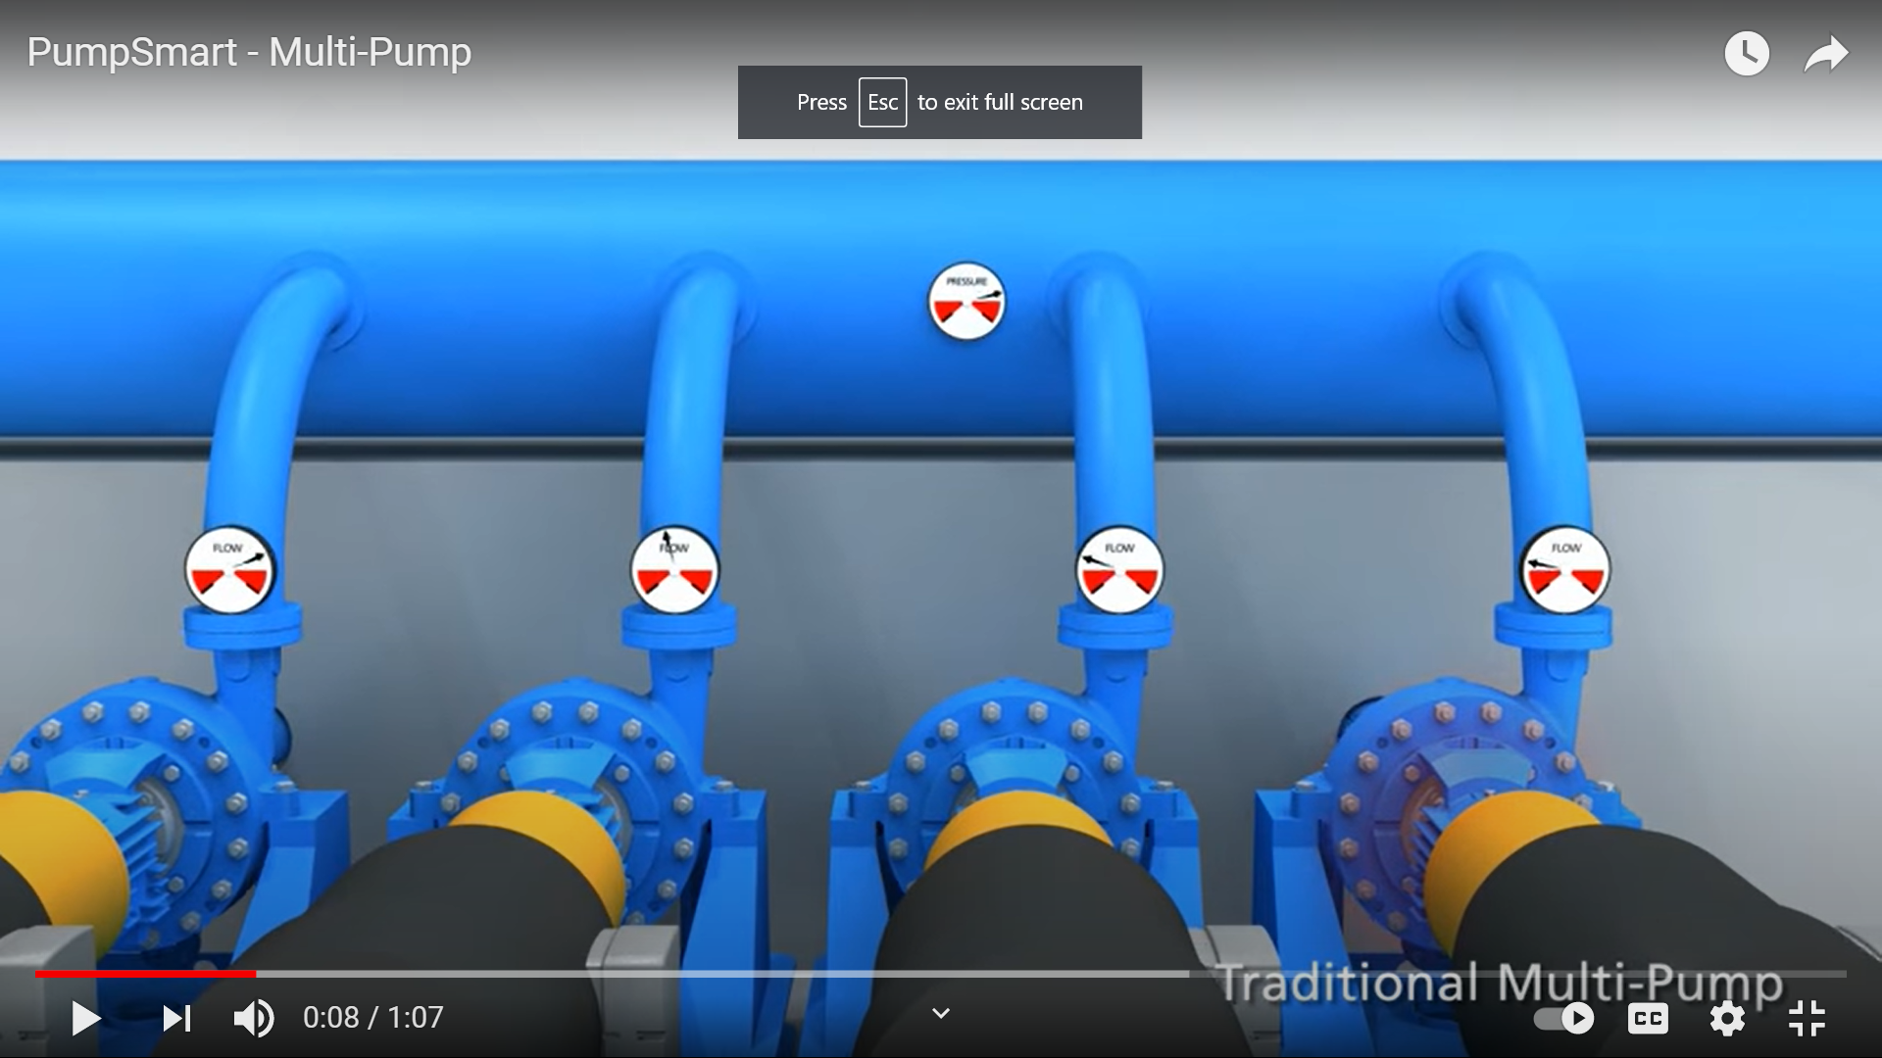
Energy saving in Motor Systems –
3) Coordination between motor groups
The motor works around maximum efficiency when continuously loaded by 75%-100% of its rated power.
    Degree of deployment
The motors of different operating load that work together must be coordinated their operational sequence per each motor so that each motor will operates at the optimum efficiency
Ease of implementation
    Cost of implementation
Savings

Slide 9
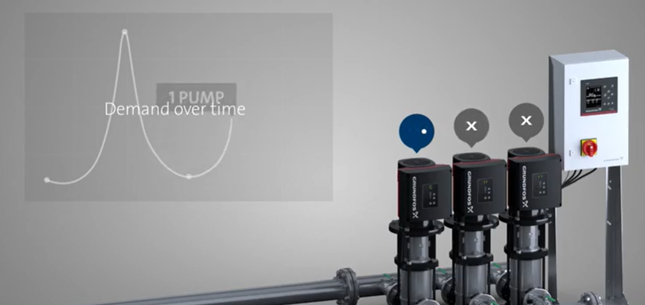
Energy saving in Motor Systems –
3) Coordination between motor groups
For a group of motors serving a certain load (compressor, pump, chiller), the coordination between motors shall be considered to satisfy the load properly
Advanced control equipment shall be used, such as sequencers, IPC and CEOS.
    Degree of deployment
Ease of implementation
    Cost of implementation
Savings

Slide 10
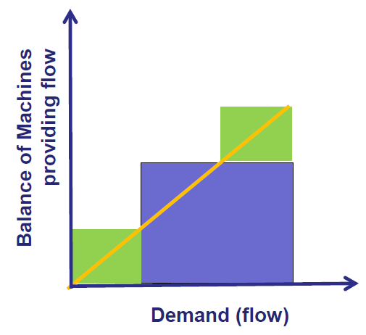
Energy saving in Motor Systems –
3) Coordination between motor groups
    Degree of deployment
Using a small rating compressor compatible with a small load
Ease of implementation
    Cost of implementation
Savings

Slide 11
Energy saving in Motor Systems –
3) Coordination between motor groups
    Degree of deployment
If the load is higher than the capacity of the small compressor, the need to use a larger compressor appears
Ease of implementation
Using a small rating compressor compatible with a small load
    Cost of implementation
Savings

Slide 12
Energy saving in Motor Systems –
3) Coordination between motor groups
    Degree of deployment
Use a large compressor to meet a large load need
Ease of implementation
    Cost of implementation
Savings

Slide 13
Energy saving in Motor Systems –
3) Coordination between motor groups
If the load is higher than the capacity of the large compressor, the need to use an additional compressor appears
    Degree of deployment
Ease of implementation
    Cost of implementation
Savings

Slide 14
Energy saving in Motor Systems –
3) Coordination between motor groups
The best sequence of use of compressors to obtain the highest efficiency according to the value of load
    Degree of deployment
Ease of implementation
    Cost of implementation
Savings

Slide 15
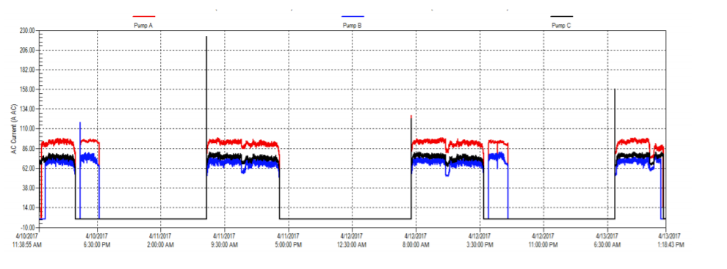
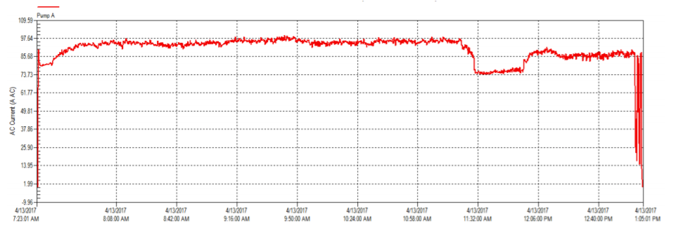
Energy saving in Motor Systems –
3) Coordination between motor groups
Practical example:
Achieving consistency between three pumps has led to a decrease in the excess current of the pump of the highest load.
    Degree of deployment
Ease of implementation
    Cost of implementation
Savings

Slide 16
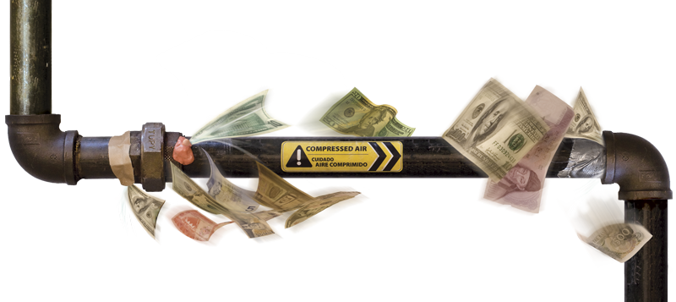
Energy saving in Motor Systems –
4) Reducing Air Pressure
Intervention with high spread level and low cost, however with medium savings and relatively not easy to be implemented
A reduced pressure of 1 bar of compressed air system decreases the electricity consumption by 7%
Pressure can be reduced by:
Prevention of leak
Local boosters
Enough air storage
    Degree of deployment
Ease of implementation
    Cost of implementation
Savings

Slide 17
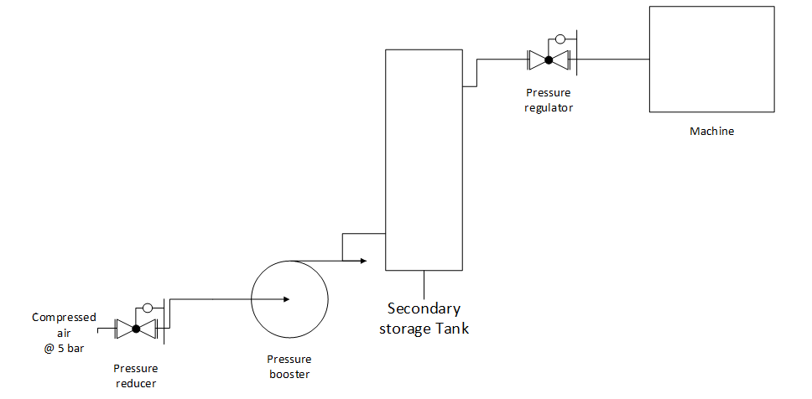
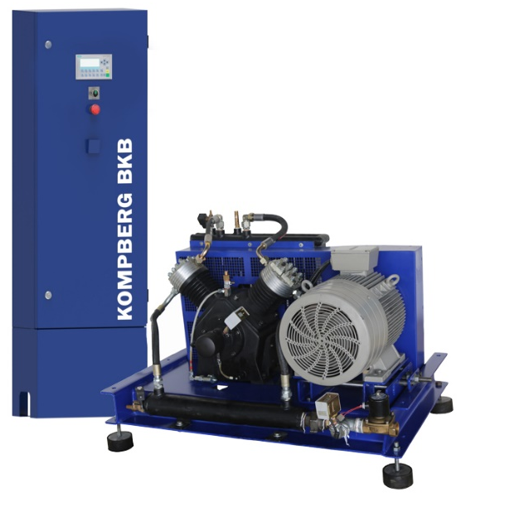
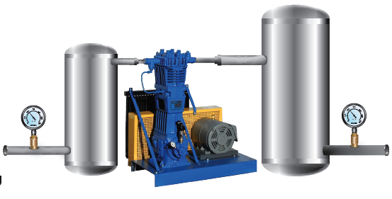
Energy saving in Motor Systems –
4) Reducing Air Pressure
Example:
Using a booster at the higher-pressure equipment at the end of the line while reducing the pressure for the rest of the line
    Degree of deployment
Ease of implementation
    Cost of implementation
Savings

Slide 18
Energy saving in Motor Systems –
4) Reducing Air Pressure
Proposed Solution Settings
No of compressors | 3 | Kaeser BSD 83 ( 6 – 7 bar) Atlas Copco GA 45 (5.7 – 6.7 bar) Atlas Copco GA 37 (5.3 – 6 bar ) Atlas Copco GA 37 (5.3 – 6 bar ) “Stand-by”
New Network Setting pressure | 5.5 bar
Energy saving percentage per one bar reduction | 6.5%
Total Energy saving | 16.25%
No of air pressure boosters | 1 (580 L/min) + 1 (1600 L/min)
No of Secondary Tanks | 1 (0.5 mᶟ) + 1 ( 1 mᶟ)
No of Primary Tanks | 1 (6 mᶟ)
Annual Energy saving | 189,961 kWh
Economic Features
CAPEX | USD 6500
Lifetime | 5 years
Total Net Saving Over Lifetime | USD 35,600
Payback Period | 1 Year
    Degree of deployment
Ease of implementation
    Cost of implementation
Savings

Slide 19
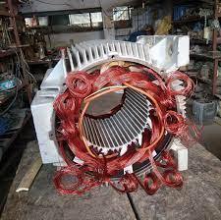
Energy saving in Motor Systems –
5) Good Rewinding Practices
Low-ease, medium-cost, high-prevalence intervention in industrial enterprises, plus average savings
Motor rewinding is essential process.
Most manufacturers advise to rewind the motor once or twice max and then replace it.
Theoretically, motor rewinding can keep the motor efficient.
In Egypt: Motor efficiency drops from 2.5% to 5% with each motor rewinding
Although the cost of motor rewinding is lower than replacing by a new motor, the losses due to the rewinding increases each time the motor is being rewound.
    Degree of deployment
Ease of implementation
    Cost of implementation
Savings

Slide 20
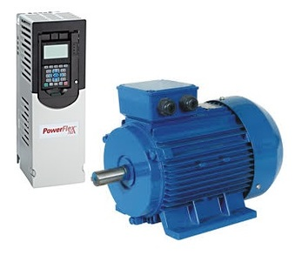
Energy saving in Motor Systems –
6) Variable Speed Drives (VSD)
Medium intervention in ease of implementation and relatively high cost and low prevalence in industrial enterprises in addition to being high savings
Variable speed drives (VSDs) enable the motor to operate at various loads with the same efficiency
There's a power loss at the VSD itself!
VSD is recommended when load changes between 25%-100%
If there is a group of motors to supply the load, you don't usually need more than one VSD
    Degree of deployment
Ease of implementation
    Cost of implementation
Savings

Slide 21
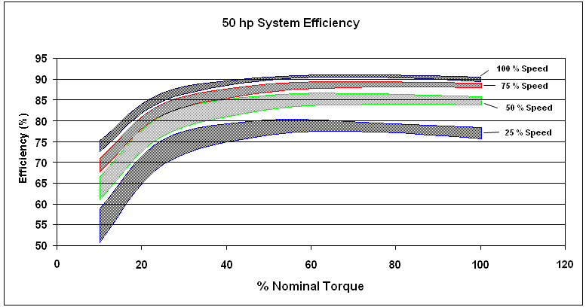
Energy saving in Motor Systems –
6) Variable Speed Drives (VSD)
VSD is recommended when the load changes between 25%-100%
    Degree of deployment
Ease of implementation
    Cost of implementation
Savings

Slide 22
Energy saving in Motor Systems –
6) Variable Speed Drives (VSD)
    Degree of deployment
Relative Price Difference - Motors with a variety of efficiency with the addition of a VSD
Ease of implementation
    Cost of implementation
Savings

Slide 23
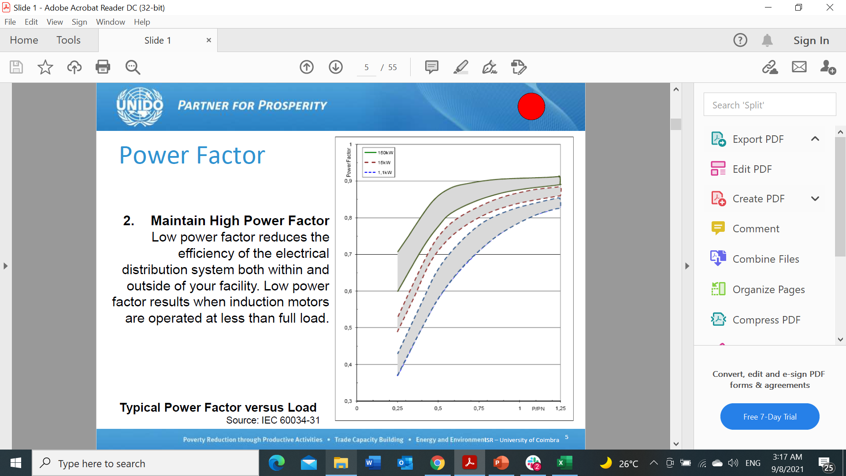
Energy saving in Motor Systems –
7) Good Selection of Motor
    The use of an over-rated motor (load less than 50% of motor rating) significantly reduces efficiency
    Degree of deployment
Ease of implementation
    Cost of implementation
Easy-to-implement, low-cost, high-prevalence intervention in industrial enterprises and low savings
Savings

Slide 24
Energy saving in Motor Systems –
8) Use High-Efficient Motors
Increased efficiency from IE level to another save energy and expenses, especially with large motor ratings and longer operating hours
    Degree of deployment
Ease of implementation
    Cost of implementation
Savings

Slide 25
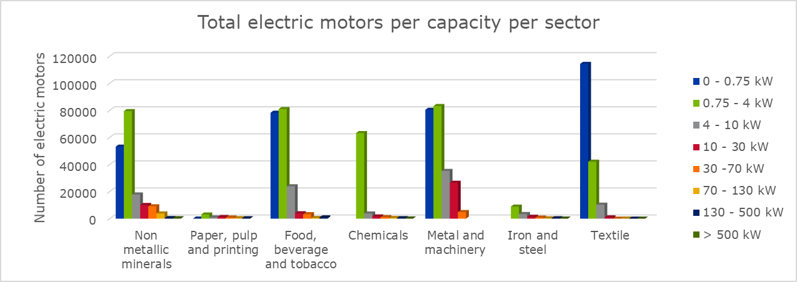
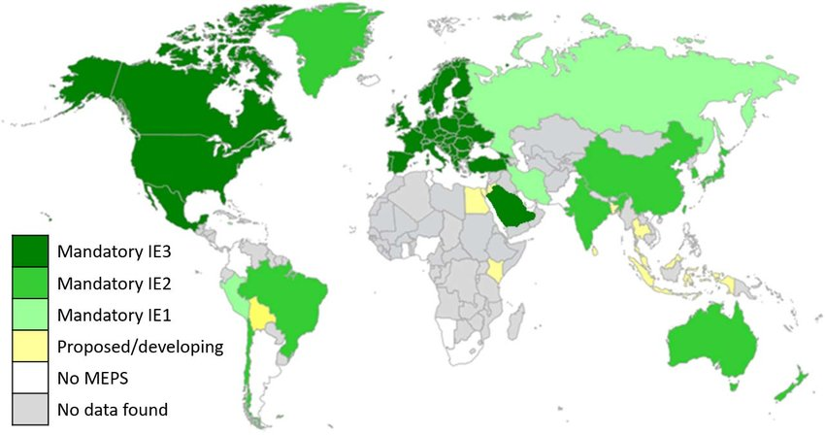
Decree 463/2020
Follows the global theme aimed at raising the efficiency of electric motors
The Decree has two parts:
  Name Plate (labeling)
  Minimum Energy Efficiency (MEPS)
62% of factories have not heard of the decree
70% see the decree as positive when understood

Slide 26
Decree 463/2020 (MEPS IE3)
The efficiency of electric motors is defined by IE1, IE2, IE3, IE4, IE5
Each group is 15-20% higher than the lower (IE1) to the top (IE5) group
77.5% of electric motors in Egypt are IE0
The decree prohibits entry of new motors to the Egyptian market which are below IE3 like many countries of the world within 18 months of the decree
TECHNICAL NOTE: IEC 60034-30-1 standard on efficiency classes for low voltage AC motors, ABB
مصدرالبيانات:

Slide 27
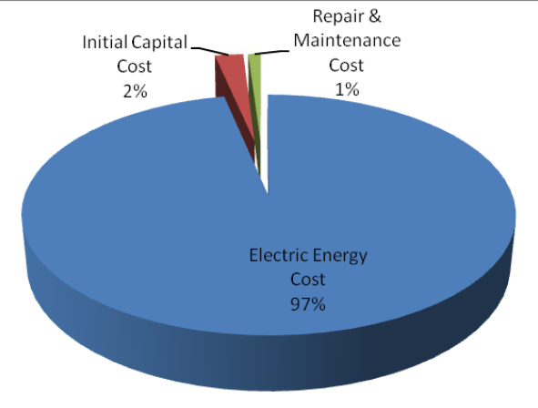
Decree 463/2020 (MEPS IE3)
The article on MEPS targets a capacity of between 0.75 and 375 kW, and the decree applies only to
  Squirrel cage induction motors
  Number of poles (2,4,6,8)
  Single-speed motors
  Less than 1000 volts
  Continuous duty motors (S1 Type)
  Direct on-line operated motors
Capex
Maintenance
مصدرالبيانات:
Source: UNIDO Motor Training

Slide 28
Decree 463/2020 (MEPS IE3)
The decree does not apply to:
  Multi-speed motors
  Motors fully integrated into equipment such as fans, pumps, plastic machines, production equipment or VSDs
  Braking motors
  Submersible motors and motors operating in an explosive environment
Capex

Slide 29
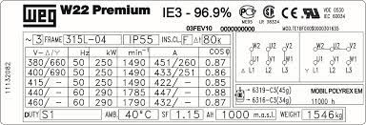
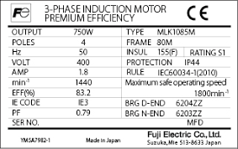
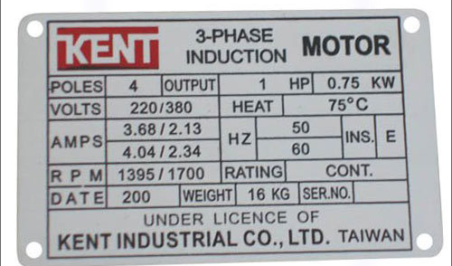
Decree 463/2020- Name Plate
The decree indicates the need to declare the degree of energy efficiency on the name plate
For AC motors
Capacity ranges from 0.12 to 1000 kW
Aims to inform the buyer of the product's consequences on energy consumption
Builds on the Electricity Law of 2015

Slide 30
How to make a replacement decision – To Repair or to Replace dilemma?
High-efficiency motors are more expensive than the less efficient ones.
Replacing a motor before the end of its lifetime is usually expensive and useless.
Electric motors damage can be an opportunity to replace it with a higher efficiency motor
But repairing will be less expensive (and also less efficient)
Source:
IFC National Energy Efficient Motors Manufacturing Roadmap 2018

Slide 31
How to make a replacement decision – To Repair or to Replace dilemma?
The higher cost of replacement can be compensated by saving.
The more efficient the motor is, the more expensive now but less cost on the long term.
Shall I repair the motor or replace it with a medium-efficiency motor? or replace it with a high-efficient motor?
The decision can be made as the cost difference is an investment and the savings are income from that investment
Source:
TECHNICAL NOTE: IEC 60034-30-1 standard on efficiency classes for low voltage AC motors, ABB

Slide 32
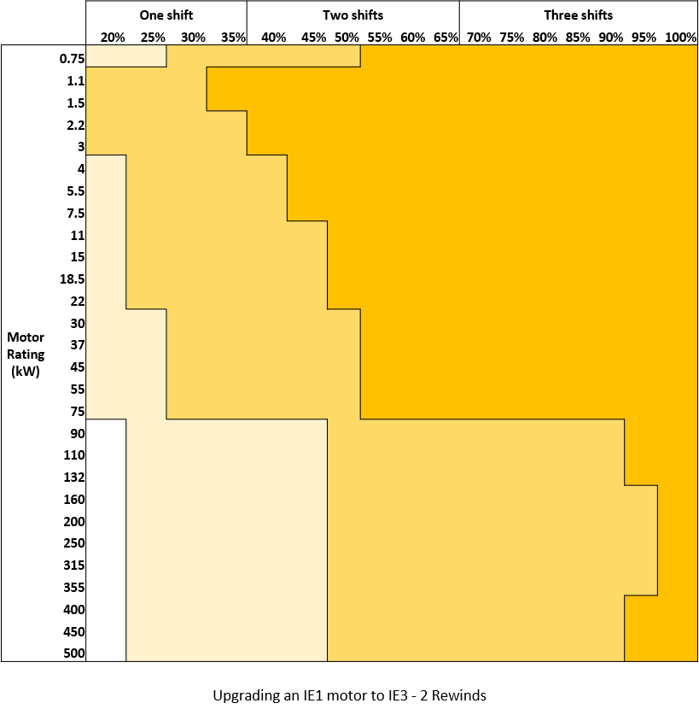
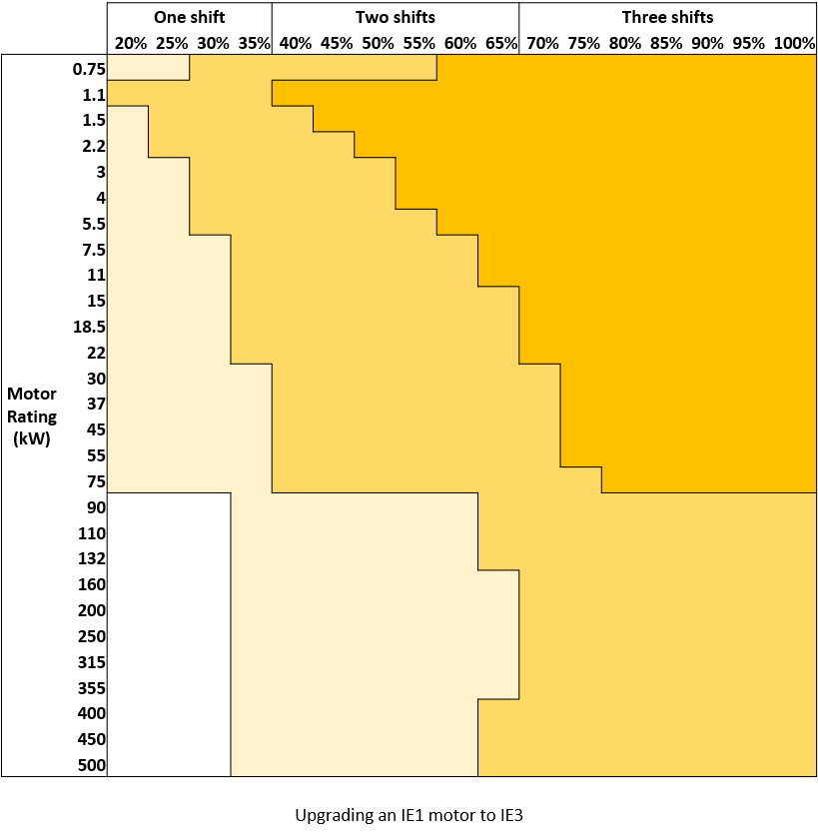
Results - Replacement of IE1 motor by IE3 Motor
The longer the annual operating time of the motor, the shorter the payback period of the EE motor (i.e. more feasible)
0-1.5 Year
0-1.5 Year
1.5- 3 Years
More than 6 years
More than 6 years
3- 6 Years
1.5- 3 Years
3-6 years
3-6 years
Replacing IE1 with IE3- rewinding 2 times
Replacing IE1 with IE3
Notes:
The labels above the load factor indicate the number of operating shifts in the facility

Slide 33
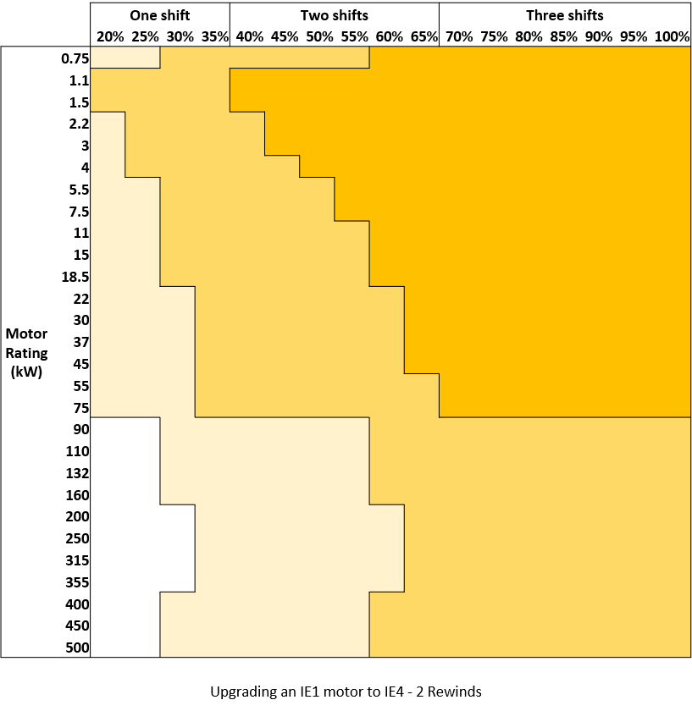
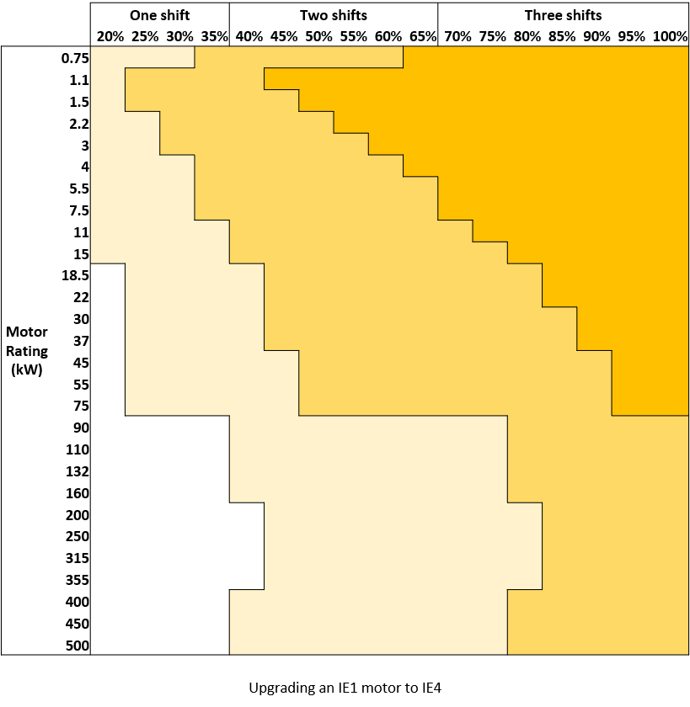
Results - Replacement of IE1 motor by IE4 Motor
The longer the annual operating time of the motor, the shorter the payback period of the EE motor (i.e. more feasible)
0-1.5 Year
0-1.5 Year
1.5- 3 Years
1.5- 3 Years
More than 6 years
3-6 years
More than 6 years
3-6 years
Replacing IE1 with IE4- rewinding 2 times
Replacing IE1 with IE4
Notes:
The labels above the load factor indicate the number of operating shifts in the facility

Slide 34
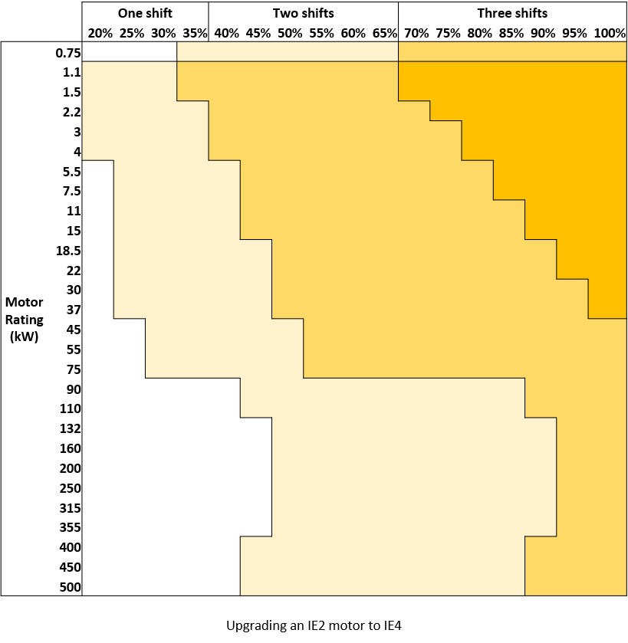
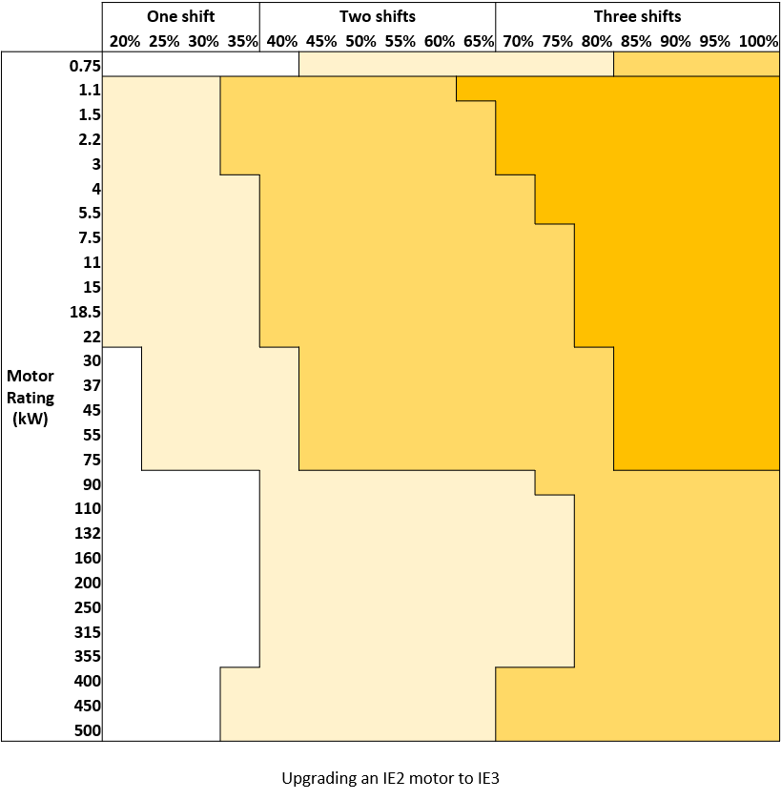
Results - Replacement of IE2 motor by IE3/IE4 motor
The higher the efficiency of the original motor to be replaced, the less economic feasibility
0-1.5 Year
0-1.5 Year
1.5- 3 Years
1.5- 3 Years
More than 6 years
3-6 years
More than 6 years
3-6 years
Replacing IE2 with IE4
Replacing IE2 with IE3

Slide 35
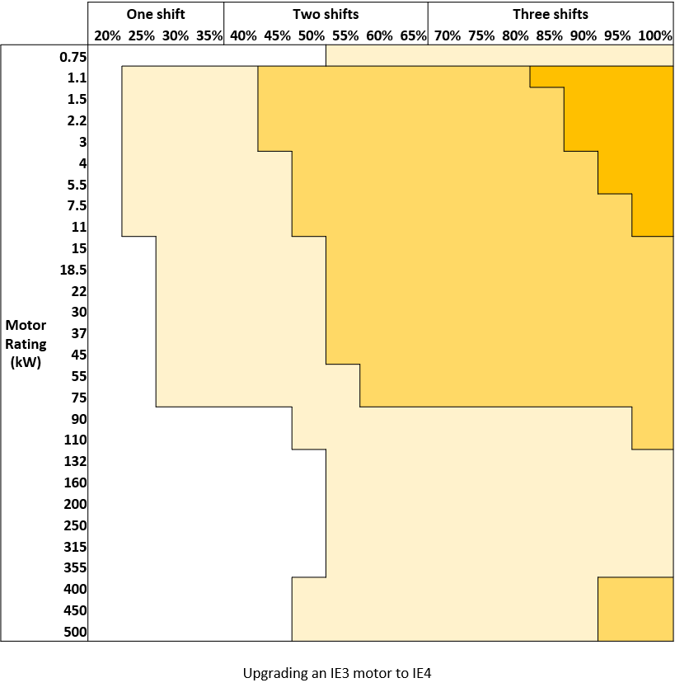
Results - Replacement of IE3 motor by IE4 Motor
0-1.5 Year
1.5- 3 Years
More than 6 years
3-6 years
Replacing IE3 with IE4

Slide 36
How to make a replacement decision – To Repair or to Replace dilemma?
Purchasing
Finance
Feasibility
Payback Period
Evaluating alternatives
Replacement plan
Production
Maintenance

Slide 37
How to make a replacement decision – To Repair or to Replace dilemma?
Example: If the IE1 motor is defective, should I repair it vs replace it by the IE3 or IE4?
Replacing IE4 | Replacing IE3 | Repair of IE1 | 100 KW motor
750,200 | 500,000 | 120,000 | Cost in EGP
8,000 | 8,000 | 8,000 | Annual Operating hours
5% | 7% | 25% | loss
40,000 | 56,000 | 200,000 | Loss per year, kWh
50,000 | 70,000 | 250,000 | Loss per year, EGP
200,000 | 180,000 | 0 | Saving Versus Repair
3.2 | 2.1 |  | Payback period

Slide 38
Green Financing
Federation of Egyptian Industries (FEI) and National Bank of Egypt- Low interest rate
EBRD- National Bank of Egypt- Arab African Bank- QNB - 10% grant
KFW- CIB- National Bank of Egypt- Low interest rate
EBRD- Value chain program- QNB- 10% grant
MSMEDA- Low interest rate
Notes:
Tracking running hours can be achieved cheaply using counters/totalizers that operate based on the motors control signals

Slide 39
Key Points
The above represents are preliminary performance indicators and does not replace the need of feasibility study
A survey of the electrical motors in the facility should be developed considering the records of the number of repair times and annual operating hours of each motor
Repairs should be carried out in reputable workshops and repairs should be tested in the workshop if possible
Follow the manufacturer’s instructions during motor installation to avoid excessive power losses and other problems that may affect motor lifetime
Motor replacement could be the least expensive decision in the long run.
It was assumed that the motor under study had already been repaired once, reducing its efficiency by 2.5% to 5%, which represents bad repair practices.
Notes:
Tracking running hours can be achieved cheaply using counters/totalizers that operate based on the motors control signals

Slide 40
Key Points
Motor repair costs range from 10% to 30% of motor price
To estimate the price of the new motor, it was assumed that the IE2 motor costs 1,350 EGP/kW, with a 30% increase between each IE level and the higher IE level
The efficiency values used in the study are those of squirrel cage, 4-poles, single-speed motors, which are larger than 1 hp.
The recovered value of the motors was neglected when replaced
Notes:
Tracking running hours can be achieved cheaply using counters/totalizers that operate based on the motors control signals

